Slide 1
Layer details NEWUHF TRX
2023-09-03

Slide 2
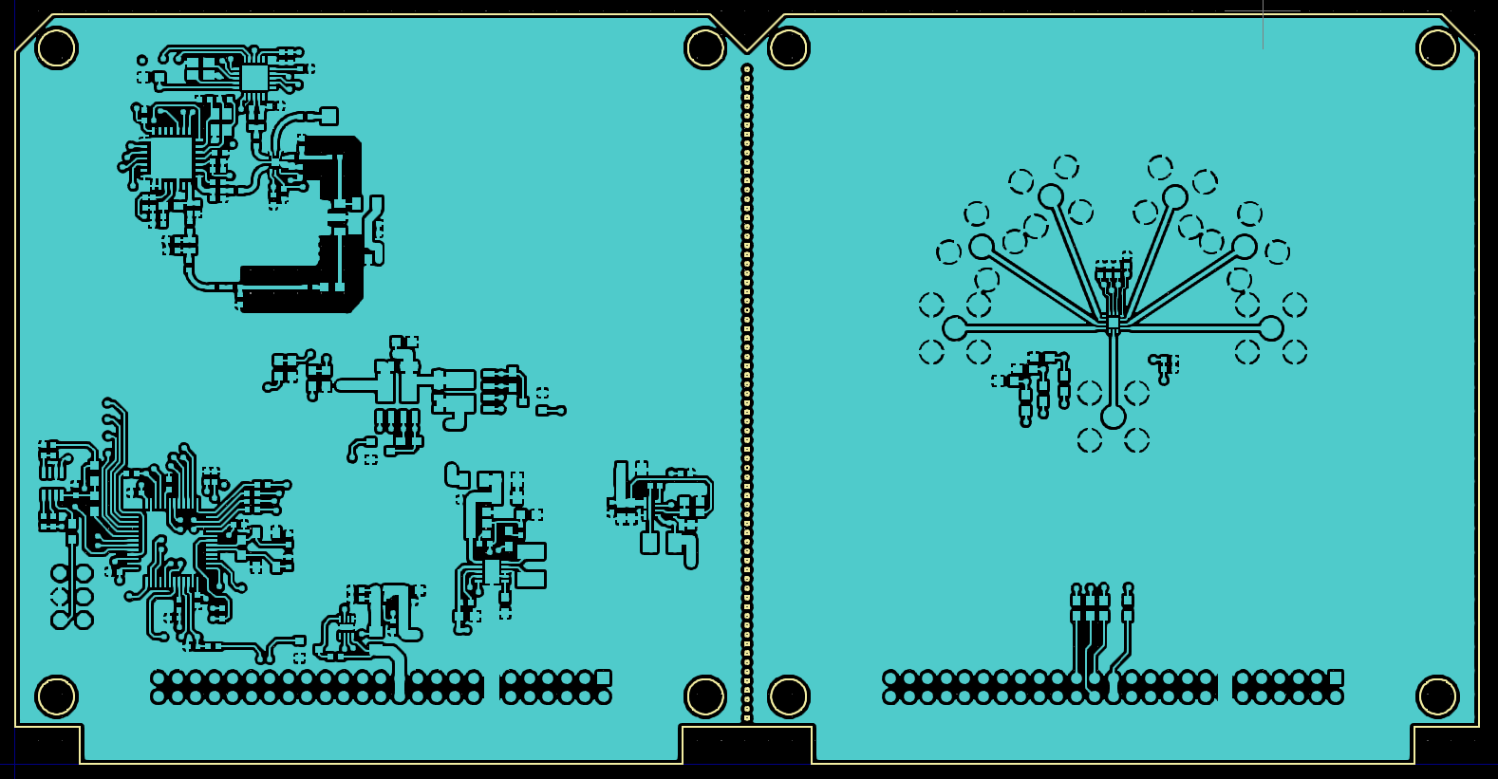
TOP LAYER

Slide 3
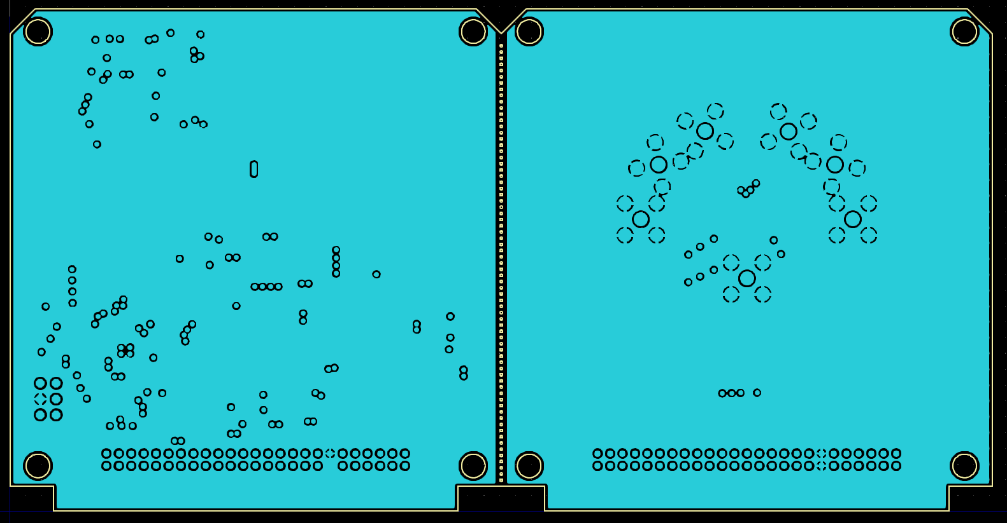
LAYER 2 (GND PLANE)

Slide 4
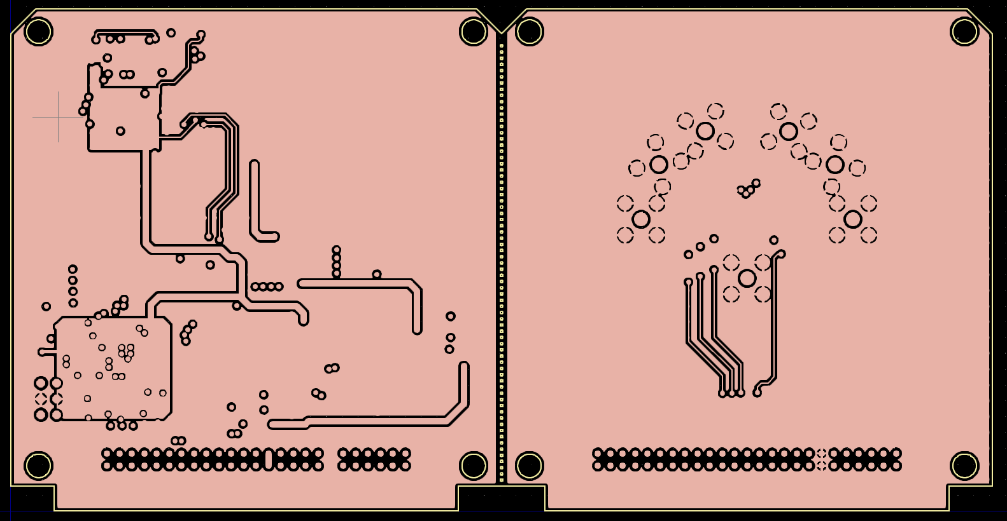
LAYER 3 (GND Layer+power)

Slide 5
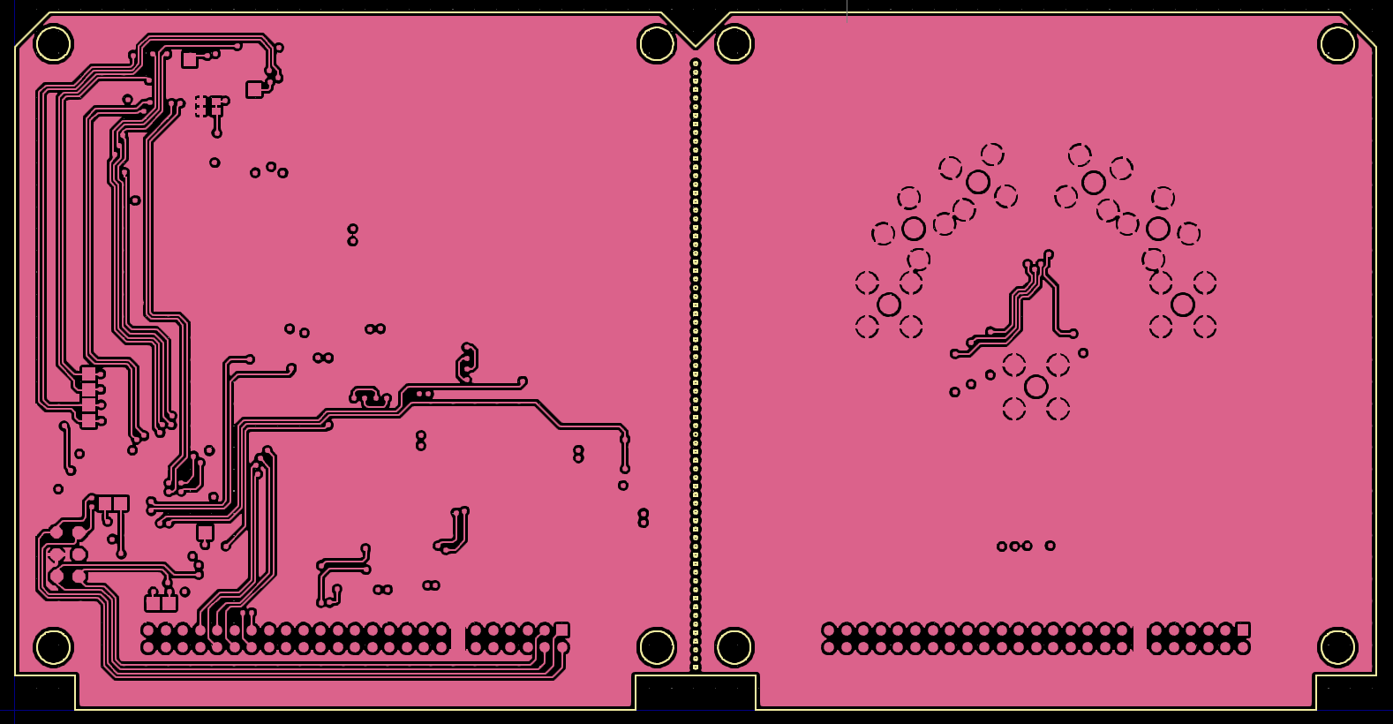
BOTTOM LAYER (By looking from top side)

Slide 6
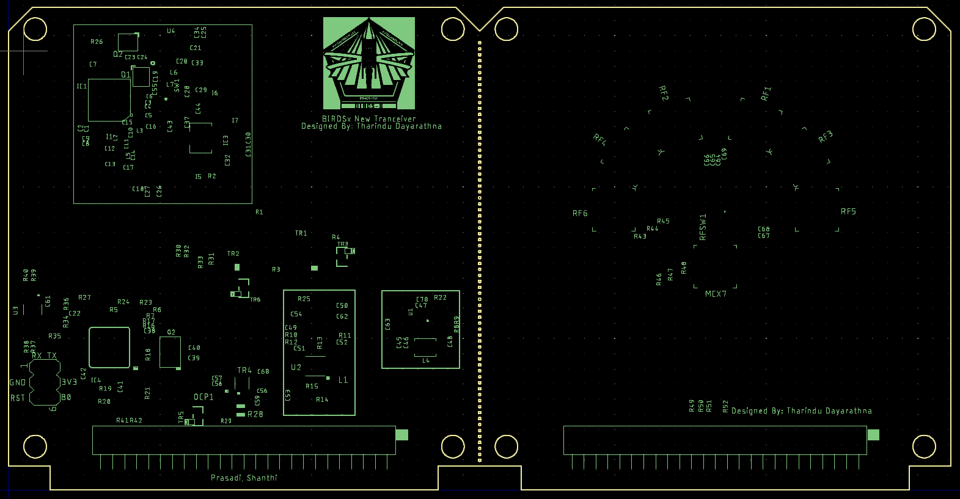
TOP SILK (No bottom silk)

Slide 7
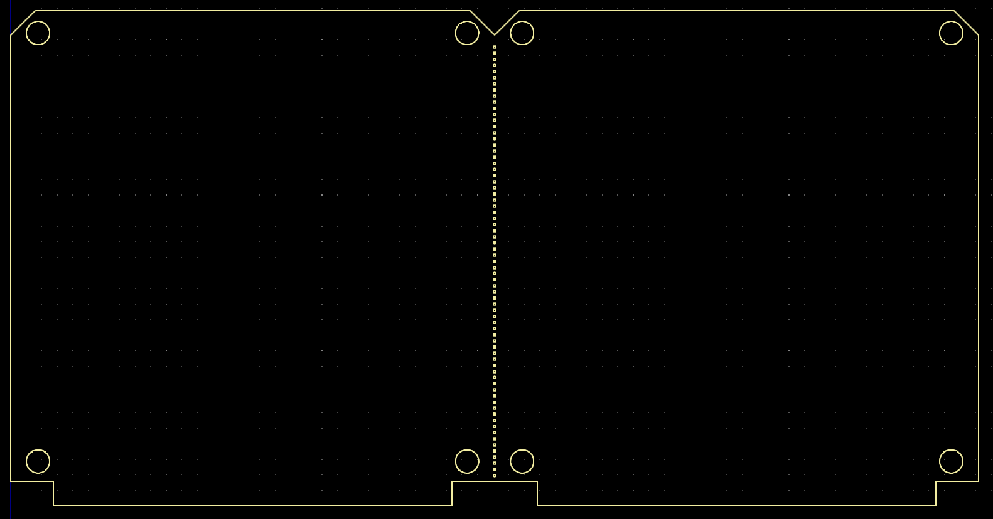
BOARD OUTLINE

Slide 8
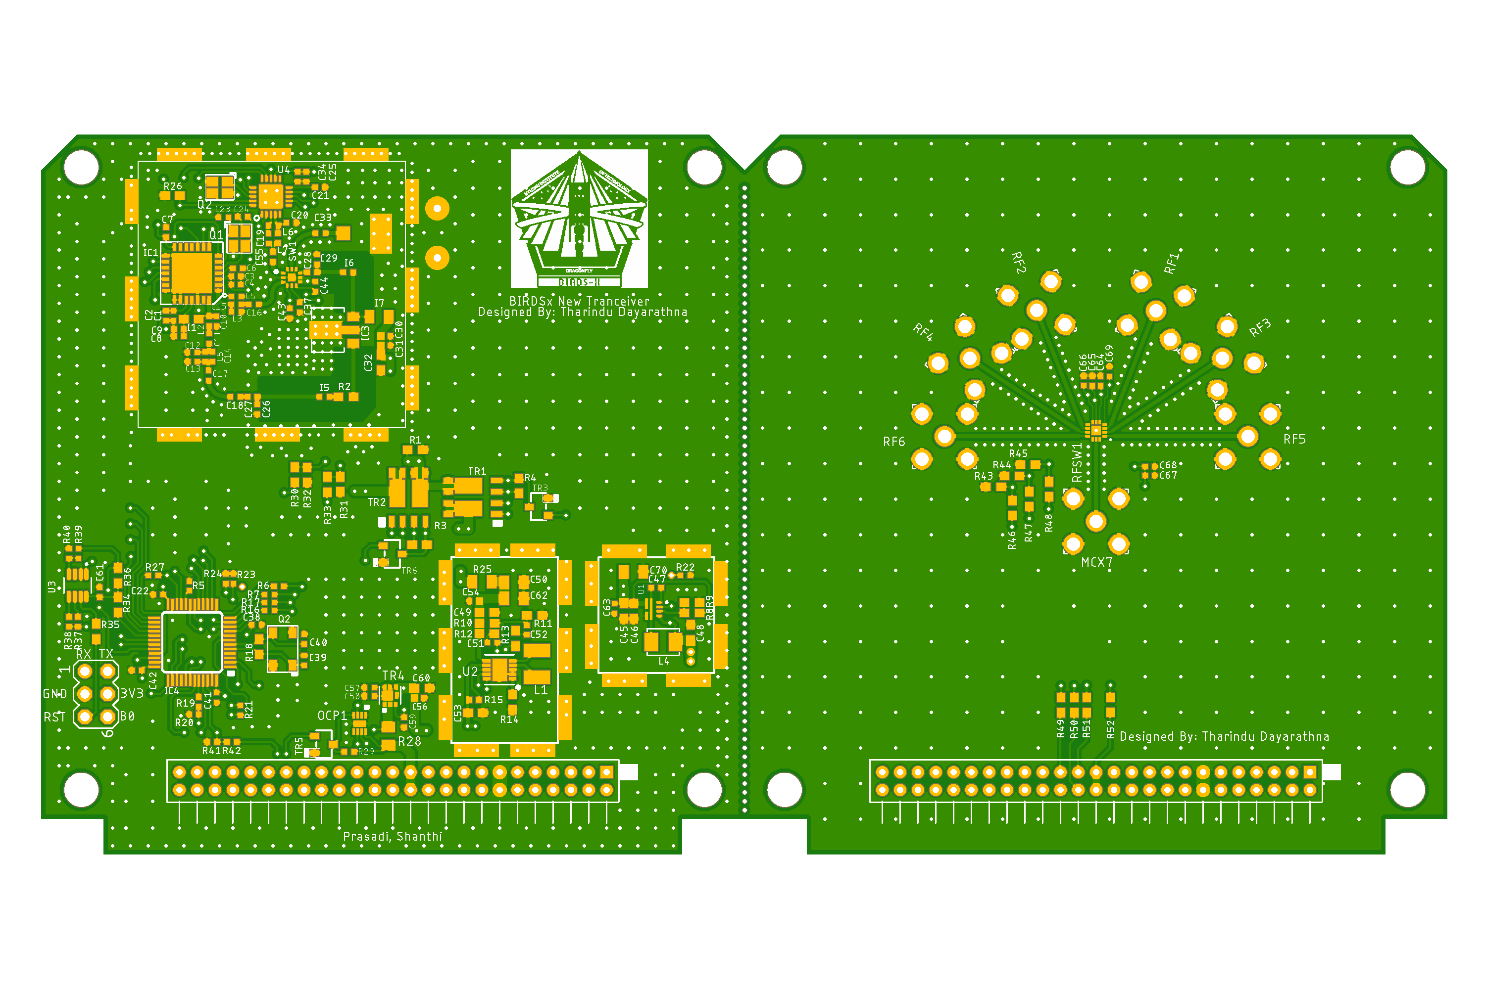
MOUNTING DRAWING - 1

Slide 9
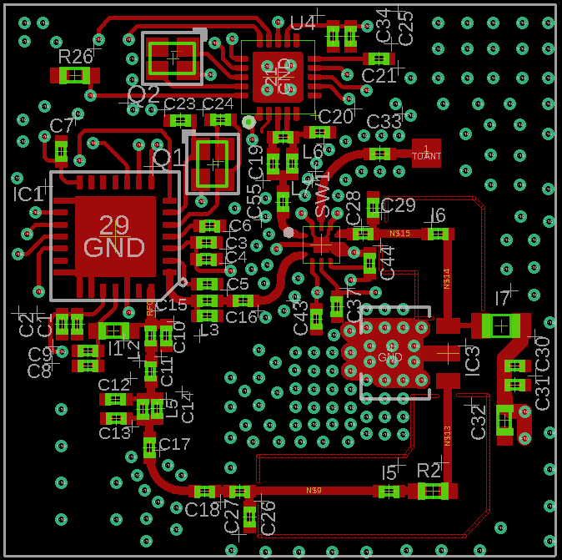
MOUNTING DRAWING - 2

Slide 10
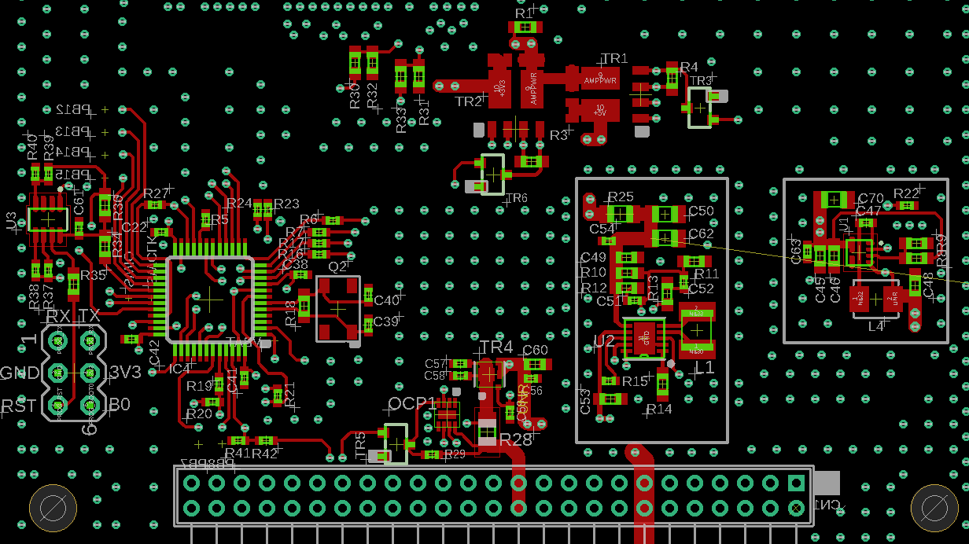
MOUNTING DRAWING - 3

Slide 11
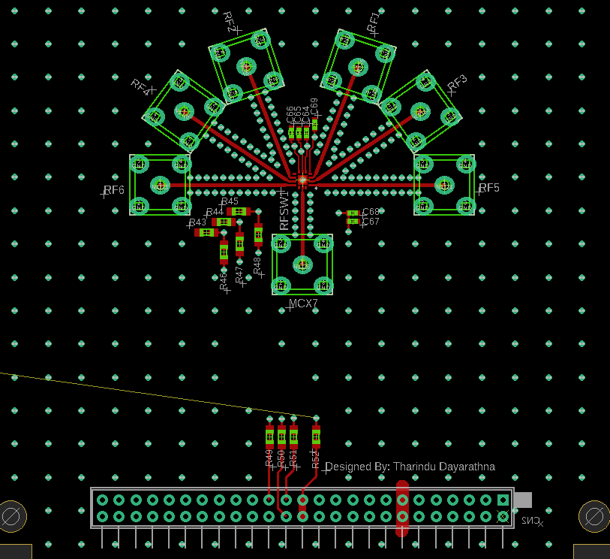
MOUNTING DRAWING - 4

